Slide 1
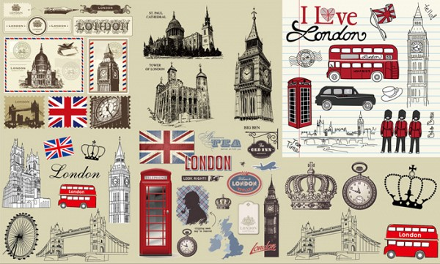
Jeff Mac Osei
Capstone Project
The Battle of Neighborhoods
Copyright © 2020

Slide 2





Contents
Problem Understanding
Data Acquisition
Data Preparation
Visualization and Insights
Results and Discussions
Conclusion

Slide 3

Problem Understanding
Understanding the problem is the first step of any problem-solving
Problem Statement
London is one of the most popular places for tourists and vacations. This may be due to the fact that London is made up of diverse people, multicultural and offers a wide variety of experiences for tourists. In this project, we will try to group the neighborhoods of London and draw insights to what they look like now. This is to help tourists and people who have intentions of migrating make good decisions based on the insights that will be drawn from this project.
Project Goal
The goal of this project is to explore city of London and find out what makes this city one of the popular destinations for tourists.

Slide 4
Data Acquisition
The process of collecting, gathering and filtering data from external sources
To complete the project in full, we need the geographical location data for London. Postal codes in the city serve as a starting point. Using Postal codes, we can easily find out the neighborhoods, boroughs, venues and their most popular venue categories that can be used for this purpose.
For this project we decided to acquire information from Wikipedia
Finally, we will use the Foursquare API to gather information about venues inside each and every neighborhood. For each neighborhood, we have chosen the radius to be 500 meters.
Data Collected
The information acquired from this site includes:
Location
London Borough
Post Town
Postcode District
Dial Code
OS Gride ref
This Wikipedia page lacks information about the geographical locations. To solve this problem, we use ArcGIS API.

Slide 5




Data Preparation
Is a great way to visualize information about users
Data Blending
Data Quality Assessment
In this step, we merged two data frames into a single data set.
This step allowed us to detect columns with issues which consequently guided us during the cleaning process.
DATA PREPARATION CYCLE
Formatting
Cleansing
In this step of the data preparation, we formatted data columns to contain the appropriate data
In this step, we resolved various issues found in our data. Issues included;
Missing values

Slide 6
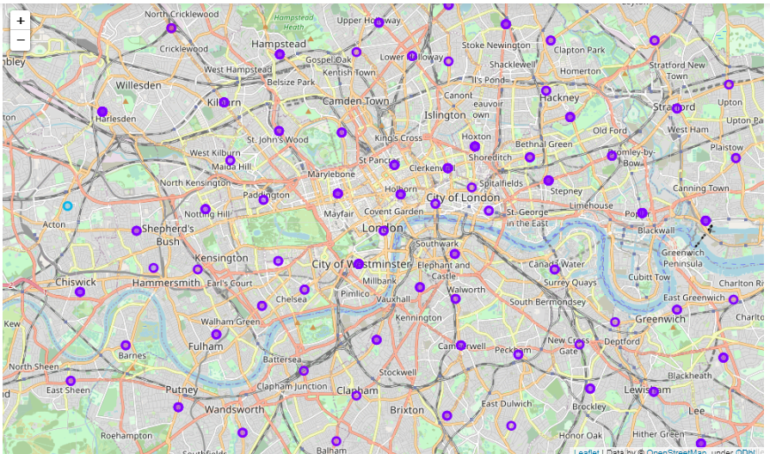
Visualization and Insights
Map of various features ibn neighborhoods
We can see from the graph the names of various features present in the neighborhoods of London which consequently attracts more tourist to the city of London.

Slide 7
Results and Discussion
Summary of various findings
The neighborhoods of London are very multicultural.
There are a lot of different cuisines including Indian, Italian, Turkish and Chinese. London seems to take a step further in this direction by having a lot of Restaurants, bars, juice bars, coffee shops, Fish and Chips shop and Breakfast spots.
It has a lot of shopping options too with that of the Flea markets, flower shops, fish markets, Fishing stores, clothing stores. The main modes of transport seem to be Buses and trains. For leisure, the neighborhoods are set up to have lots of parks, golf courses, zoo, gyms and Historic sites.
Overall, the city of London offers a multicultural, diverse and certainly an entertaining experience.

Slide 8
Conclusion
Be bold, be courageous and be your best
The purpose of this project was to explore the city of London and find out what makes this city one of the popular destinations for tourists and migrants.
We explored the city based on the postal codes and then extrapolated the common venues present in each of the neighborhoods finally concluding with clustering similar neighborhoods together.
We could see that each of the neighborhoods in London have a wide variety of experiences to offer which is unique in it's own way. The cultural diversity is quite evident which also gives the feeling of a sense of inclusion.

Slide 9


